Slide 1
Part II
Data Management

Slide 2
Data Management (decisions …)
Variable transformations
Who should be excluded from analyses
What are reasonable cut-offs for missing data?
Adjusting for bias from non-response (“nonsampling errors”)

Slide 3
Key Data Management Steps
Means, SD
Internal Consistency (Alpha vs. Omega)
Mean differences by demographics (gender)
Data reduction (create scales)
Subgroup comparisons
Chi-square
ANOVA
Point biserial correlation

Slide 4
Data Reduction Techniques
EFA and ESEM (exploratory structural equation modeling)
Confirmatory Factor Analysis (simple structure)
Covariance analysis (multi-group)
Item Response Theory (2-PL IRT Model)
Validity (face, content, construct [concurrent, discriminant], factorial, criterion [predictive], structural)
Measurement invariance

Slide 5
Basics of CFA Simple Structure
y1
e1
λ₁
f1
λ₂
y2
e2
λ₃
y3
e3
λ₄
y4
e4
f2
λ₅
y5
e5
λ₆
y6
e6

Slide 6
Complex Factor Loading
y1
e1
λ₁
f1
λ₂
y2
e2
λ₃
y3
e3
λ₄
y4
f2
λ₅
y5
λ₆
y6

Slide 7
Examples of CFA in Medical Research
Edinburgh Postnatal Depression Scale (EPDS)
Schizotypal Personality Questionnaire (SPQ)
Jefferson Scale of Physician Empathy (JSPE)
Illness Intrusiveness Rating Scale (IIRS)
WHO QoL-BREF

Slide 8
Examples of “Hypothetical Constructs”
Depression
Cognitive Efficacy
Sexual Risk-Taking
Self-Management
Aptitude in Medicine
Patient Communication Skills
Resilience (cognitive reserve)
Drug-Related Problems (or Problem Behavior)
Quality of Life (or Well-Being)

Slide 9
In depth look at CFA
Jefferson Scale of Physician Empathy (JSPE)
Widely used measure of “empathy”
Applications to assess “doctor-patient” relationship and patient care
Is sensitive to assess change in educational interventions

Slide 10
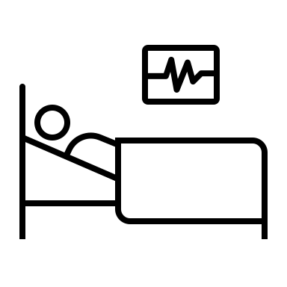
CFA Model of JSPE
Multidimensional (20-item scale)
Perspective taking
Compassionate care
Ability to stand in patient’s shoes
Only examined using EFA (PC analysis)
Data-driven approach with no inferential fit indices

Slide 11
CFA Model of JSPE
CFA = theory model driven approach, matching sample data to hypothetical model
Based on variance-covariance matrix
Inferential fit indices
How well does the sample data fit the hypothetical model?

Slide 12
Levels of Aggregation
F1
F2
x₁
x₂
x₃
x₄
scale₁
scale₂
scale₃

Slide 13
Super Factor
Doctor-Patient Communication
F1
F2
F3
F4

Slide 14
Part III
Statistical Analysis of Survey Data

Slide 15
Statistical Analysis (more decisions …)
Response scales and their distributions
Distributions of variables suitable for analyses?
Conceptualization of underlying constructs
Hypothetical … (latent variables)
Latent Classes

Slide 16
Reporting Survey Results (even more decisions …)
Walking a reader through all the decisions you made
Building a mental picture in their head
Scientific implications

Slide 17
Survey Weights
Why do we weight survey responses?
Improve the precision of survey point estimates
Reduce bias in survey estimates caused by nonresponse and noncoverage
What are the different weighting schemes?
Cross-sectional
Longitudinal surveys

Slide 18
Survey Weights
Weights are values assigned to each case
Weights help make the sample statistics (model parameters) more representative of the population (i.e., strengthens inferences)

Slide 19
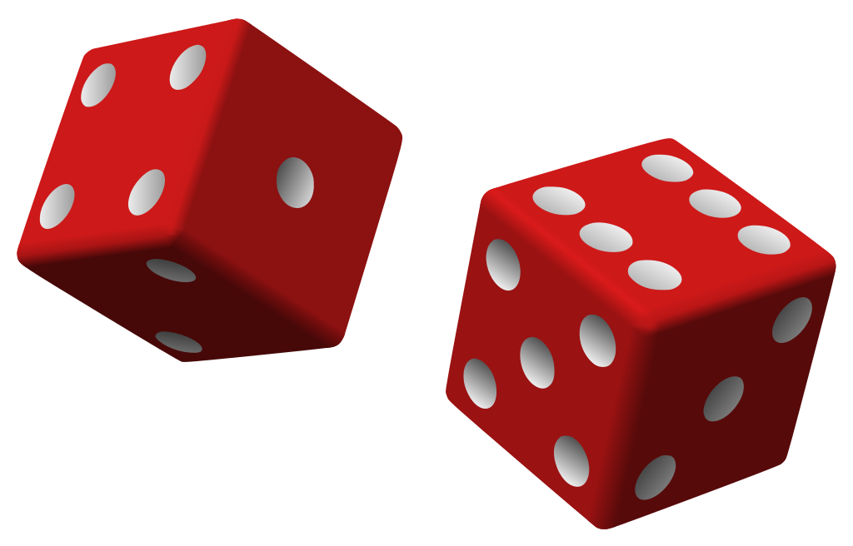
More about Survey Weights
Weights compensate for …
Unequal selection probabilities
Nonresponse
Noncoverage
Sampling fluctuations
Weights are always positive, but can be fractional
Can only use one weight at a time (Dwt * PSwt)

Slide 20
Types of Survey Weights
Design Weights (complex surveys)
Post-Stratification Weights (Non-response and selection)
Frequency weights to smooth infrequent events (i.e., drug use can be weighted by the probability of occurrence)

Slide 21
Weights are needed …
Certain kinds of people may not respond to the survey
Demographics (e.g., older, less educated, minorities)
Personality (i.e. conscientiousness vs. neuroticism)
Poverty (i.e., digital divide or access to computers)
Political Affiliation (attitudes and beliefs)

Slide 22
Types of Survey Weights
Weighting for unequal selection probability (Design weight):
1/(sampling fraction)
“the reciprocal of the
Selection probabilities are known (trimming helps precision)
Nonresponse adjustments usually made in one single operation with cross-sectional data
inclusion probability”

Slide 23
Survey of medical providers and prior authorization
Proportional representation of medical practice specialties in the US¹
Specialty | Number (percent) | Inverse proportional weight
Dermatology | 12516 (1.333%) | 1/.01333 = .7502
Gastroenterology | 15469 (1.65%) | 1/1.65 = .6061
Internal Medicine | 120171 (12.798%) | 1/12.798 = .07814
Neurology | 14146 (1.51%) | 1/1.51 = .6623
Hematology/Oncology | 16274 (1.733%) | 1/1.733 = .5770
Psychiatrist | 38792 (4.131%) | 1/4.131 = .2421
Rheumatology | 6265 (0.667%) | 1/0.667 = 1.499
Note: ¹Source: 2020 Physician Specialty Data Report (https://www.aamc.org/). Data obtained from American Medical Association Master Physician File. N = 938980 for all licensed physicians.

Slide 24
Post-Stratification Weights
Use available information to paint a picture of factors that may contribute to non-response/selection
Gender
Age
Educational attainment
Residence (e.g., rural, urban, metropolitan)
Region of the Country
Clinic Date
School data
Organizational Information
Iterative Raking (software solutions) is often used to combine information when multiple weights are present

Slide 25
Design Effects
The value of a design effect for a particular sample design is the net effect of the combined influences of stratification, clustering, and weighting
The DEFF helps you identity the influence of extreme clustering or weighting that could affect your “inferences” based on analysis of the data …

Slide 26
Design Effects
DEFF = 1 + ρ(n-1) , where ρ (rho) is the magnitude of clustering and n is the size of the clusters.
A DEFF of 2.0 means the variance is twice as large as one would expect if you obtained a simple random sample (and there is dependence in the data).
Clustering can arise when the unit of assignment in an intervention (clinic or hospital or region) is not the same as the unit of observation (people within clinics or regions). With clustering, people within a unit are more like each other (share some environmental conditions or experience behavioral similarity through social networks).

Slide 27
Real World?
Most household surveys use …
Multistage, stratified, cluster sampling with unequal probabilities of selection
Why clusters?

Slide 28
ClusterinG
Patients within clinics
Clinics within regions
Students within classrooms
Classroom within school
Geriatric patients within nursing homes

Slide 29
Variance Inflation
Variance inflation factor is the amount of variance adjustment made to the person-level variance to account for the magnitude of clustering within the data. VIF is calculated as follows: VIF = (1 + [n – 1] ρ), where n = the average number of students within schools or clinics (and may be computed as the harmonic mean when school [or clinic] sizes greatly vary) and ρ (rho) is the intraclass correlation (ICC).
When weighting the data is a concern (there is variability in the weights as they are all not equal); lead to overestimation of variance in the model …
F = 1 + CV(w_{i})²
where CV(w_{i}) is the coefficient of variation of the weights (w_{i})
VIF is an adjustment after base weights have been applied
Using the VIF can be problematic if the sample sizes in adjustment cells are small

Slide 30
AssumptionS
Weighting sample data makes certain assumptions …
Respondents within a cell represent the “nonrespondents” in that cell (Missing at Random or MAR assumption)
The adjustment (ancillary) variables can account for missing information

Slide 31
Shifting GearS
Person-Centered vs. Variable-Centered Analyses
Or, “The search for typologies”
What do we emphasize when we examine variable-to-variable relationships?
Overlap in distributions (relations between two constructs),
Prediction (R² = variance accounted for in response),
Efficiency (pitting one predictor against another)

Slide 32
Variable-Centered Analyses
What do we emphasize when we examine variable-to-variable relationships?
Overlap in distributions (how related are two constructs),
Prediction (variance accounted for in response),
Efficiency (pitting one predictor against another)
Person-Centered vs. Variable-Centered Analyses
or, “The search for typologies”

Slide 33
Variable-Centered Analyses
Common analytic frameworks?
Correlation
Regression
ANOVA
Factor Analysis
Discriminant Function
SEM
All using covariance structure as the focus

Slide 34
Typical Linear Regression Model
Predictor
β₁
Outcome
Demographics
Covariates
Confounds

Slide 35
Assumptions of Variable-Centered Analyses?
The obtained coefficient holds for all members of the population
For a unit change in X there is a corresponding change in Y
Stated differently, whatever the “effect” of X on Y (predictor on outcome) it holds for all members of the population
Individual differences (straying from the mean) is treated as error

Slide 36
Person-Centered Analyses
Purpose?
Elucidate typologies (mixtures or latent taxa)
LCA = Latent Class Analysis
LTA = Latent Transition Analysis
GMM = Growth Mixture Models
All use response patterns as the focus

Slide 37
Person-Centered Analyses
Pressing Question You Can Ask with Survey Data …
Is there a single undifferentiated population or rather there is subgroup heterogeneity, which we term …
“discrete, mutually exclusive classes (mixtures) that are qualitatively different from each other and that exist within the population”
Subgroup heterogeneity … another way to frame “individual differences” from a holistic perspective

Slide 38
Pictorial Representation of LCA

Slide 39
What is a response pattern?
We have two manifest questions, each coded Yes/ No; therefore, we have 2² or 4 response patterns:
YY, YN, NY, and NN
If we have 8 questions, each coded Y/N we have 2⁸ = 256 possible response patterns, making it a bit more difficult to “see” the different subgroups that might underlie the data

Slide 40
What is a typology?
With cross-sectional studies, typologies are “classes” or subgroups that share behavioral similarity (i.e., coping strategies)
With longitudinal studies (LTA), typologies are “statuses” as membership can fluctuate over time (people move from one status to another).
People within a class (or status) share common response profiles, they act in a similar fashion, share characteristics that are defining based on how they respond to survey questions

Slide 41
Examples of classes
Classes are “mutually exclusive” and qualitatively different (not quantitatively different).
Membership in a class is based on an “estimate” using posterior probability distributions (most likely class) adding up to 1
There is “uncertainty” in assigning a person to class membership, bringing into question how one can relate class membership to a distal outcome (e.g., alcohol consumption, depression, mask compliance)

Slide 42
Examples Using LCA
Coping, Resilience, Cognitive Flexibility
Ecstasy Use
Peer Conformity
Self-Management Skills
Motivations to Smoke Marijuana
Frailty
Delinquency
Intimate Partner Violence
Health Risk Behaviors

Slide 43
Latent Class Analysis Model
I₁
I₂
“C”
I₃
I₄
I_{k}

Slide 44
Latent Class Multiple Group Model: Knownclass
I₁
I₂
I₃
I₄
“cg”
“C”

Slide 45
Latent Class Model with a Covariate
I₁
I₂
I₃
I₄
“C”
x

Slide 46
Mixture Model with Covariates and Distal Outcome
I₁
I₂
I₃
I₄
I₅
“C”
y
x₁
x₂

Slide 47
Item Response Probabilities
Convert Logit to Probability (Excel):
Threshold = -1.237
=1-(EXP(B5)/((1+EXP(B5))))
ρ = 0.859 ; Members of this class had a 85.9% probability of endorsing this item
In general, > .5 for a threshold (chance) is the benchmark

Slide 48
Item Response Probabilities
Threshold = 1.163
= 0.238 ; Members of this class had=1-(EXP(B5)/((1+EXP(B5))))
a 23.8% probability of endorsing this item
Latent class separation =
well functioning indicators that help to distinguish class membership
Good entropy (less chaos) = well fitting model (>.80)

Slide 49
COVID-19 STUDY OF COPING
Questions
Problem-focused coping:
e.g., “Think about choices that exist before I take any action”
Emotion-focused coping
e.g., “I get upset and let my emotions out”
Resilience
e.g., “It does not take me long to recover from a stressful event”
Cognitive Flexibility
e.g., “If I have failed to cope with stress, I think of other ways to cope”

Slide 50
IRPs = Typologies
3-Class Latent Class Analysis Example
Class #1 |  |  |  | Class #2 |  |  |  | Class #3
 | Threshold | IRP |  |  | Threshold | IRP |  |  | Threshold | IRP
Prob1 | -3.142 | 0.959 |  | Prob1 | -1.32 | 0.789 |  | Prob1 | -1.665 | 0.841
Prob2 | -1.975 | 0.878 |  | Prob2 | -1.181 | 0.765 |  | Prob2 | -1.384 | 0.800
Prob3 | -2.183 | 0.899 |  | Prob3 | -0.958 | 0.723 |  | Prob3 | -1.738 | 0.850
Prob4 | -2.796 | 0.942 |  | Prob4 | -1.663 | 0.841 |  | Prob4 | -1.663 | 0.841
Prob5 | -1.478 | 0.814 |  | Prob5 | -1.164 | 0.762 |  | Prob5 | -1.035 | 0.738
Prob6 | -1.444 | 0.809 |  | Prob6 | -0.852 | 0.701 |  | Prob6 | -1.069 | 0.744
Prob7 | -0.427 | 0.605 |  | Prob7 | 0.023 | 0.494 |  | Prob7 | 0.122 | 0.470
Emot1 | 2.009 | 0.118 |  | Emot1 | -3.722 | 0.976 |  | Emot1 | 2.548 | 0.073
Emot2 | 1.163 | 0.238 |  | Emot2 | -1.32 | 0.789 |  | Emot2 | 1.213 | 0.229
Emot3 | 2.065 | 0.113 |  | Emot3 | -1.403 | 0.803 |  | Emot3 | 2.095 | 0.110
Emot4 | 0.823 | 0.305 |  | Emot4 | -0.976 | 0.726 |  | Emot4 | 0.925 | 0.284
RESIL1 | -1.791 | 0.857 |  | RESIL1 | 0.908 | 0.287 |  | RESIL1 | -1.007 | 0.732
RESIL2 | -1.795 | 0.858 |  | RESIL2 | 2.08 | 0.111 |  | RESIL2 | -1.034 | 0.738
RESIL3 | -1.629 | 0.836 |  | RESIL3 | 1.553 | 0.175 |  | RESIL3 | -0.543 | 0.633
RESIL4 | -2.257 | 0.905 |  | RESIL4 | 1.267 | 0.220 |  | RESIL4 | -1.278 | 0.782
RESIL5 | -0.944 | 0.720 |  | RESIL5 | 0.881 | 0.293 |  | RESIL5 | -0.773 | 0.684
RESIL6 | -1.241 | 0.776 |  | RESIL6 | 1.311 | 0.212 |  | RESIL6 | -0.679 | 0.664
CogFlex1 | -2.359 | 0.914 |  | CogFlex1 | -1.137 | 0.757 |  | CogFlex1 | -0.064 | 0.516
CogFlex2 | -1.679 | 0.843 |  | CogFlex2 | -1.146 | 0.759 |  | CogFlex2 | -0.121 | 0.530
CogFlex3 | -2.824 | 0.944 |  | CogFlex3 | -2.007 | 0.882 |  | CogFlex3 | 2.561 | 0.072
CogFlex4 | -3.428 | 0.969 |  | CogFlex4 | -1.886 | 0.868 |  | CogFlex4 | 1.518 | 0.180
CogFlex5 | -2.279 | 0.907 |  | CogFlex5 | -1.67 | 0.842 |  | CogFlex5 | 1.107 | 0.248
Resilient, Flexible, Problem-Focused Copers (32.35%) |  |  |  | Non-Resilient, Flexible High-Use Copers (13.34%) |  |  |  | Resilient, Inflexible, Problem-Focused Copers (10.36%)

Slide 51
Predictors of Class Membership
 | Latent Class
 | 1 | 2 | 3 | 4 | 5 | 6
 | Non-Resilient Inflexible Venters | Resilient Inflexible Non-Copers | High-Use Copers | Resilient Inflexible Venters | Non-Resilient Flexible Venters | Resilient Flexible Venters
 | 32.9% | 12.9% | 12.9% | 19.7% | 9.9% | 11.4%
Adjusted Odds Ratio
Age | 0.98 | ref | 0.97 | 0.96 | 0.94 | 0.96
Gender | 3.27† | ref | 3.52† | 2.68† | 3.73† | 2.28
Race | 0.86 | ref | 0.81 | 1.00 | 1.45 | 0.80
Employment | 1.02 | ref | 1.57 | 0.96 | 1.25 | 1.15
Living with Family | 0.68 | ref | 0.74 | 0.60 | 0.81 | 0.54†
Living with Roommate | 0.74 | ref | 0.96 | 0.73 | 0.54 | 0.76
Earned Degree | 1.37 | ref | 1.05 | 1.33 | 1.85 | 1.22
Some Schooling | 1.03 | ref | 1.06 | 1.05 | 1.43 | 1.07
Centrality | 0.88 | ref | 0.58** | 0.94 | 0.64* | 0.72†
Uncontrollability | 1.11 | ref | 1.72 | 1.05 | 1.43 | 1.20
Threat | 0.68† | ref | 0.41*** | 0.80 | 0.53** | 0.53**
Catastrophic Thinking | 0.09*** | ref | 0.47*** | 0.69† | 0.19*** | 1.64
Impulsivity | 0.42*** | ref | 0.90 | 0.44*** | 0.41*** | 0.53***

Slide 52
Mplus Syntax for LCA with Covariates
TITLE: 3-Class LCA Model
DATA: FILE = "directory for your data\Bologna.dat";
VARIABLE:
NAMES = PF1 PF2 PF3 PF4 PF5 PF6 PF7 EF1 EF2 EF3 EF4 Resil1 Resil2 Resil3
Resil4 Resil5 Resil6 Age Male White JobLoss LiveFam EarndDgr ;
MISSING=.;
USEVARIABLES are PF1 PF2 PF3 PF4 PF5 PF6 PF7
Resil1 Resil2 Resil3 Resil4 Resil5 Resil6
Age Male White JobLoss LiveFam EarndDgr ;
CATEGORICAL are PF1 PF2 PF3 PF4 PF5 PF6 PF7
Resil1 Resil2 Resil3 Resil4 Resil5 Resil6 ;
CLASSES = C(3);
AUXILIARY = (R3STEP) Age Male White JobLoss
LiveFam EarndDgr ;

Slide 53
ANALYSIS:
TYPE = MIXTURE;
STARTS = 0;
MODEL:
%C#1% !Resilient, Problem-Focused Copers = REF CLASS
[RESIL1$1*-1.791 RESIL2$1*-1.795 RESIL3$1*-1.629 RESIL4$1*-2.257
RESIL5$1*-0.944 RESIL6$1*-1.241 PF1$1*-3.142 PF2$1*-1.975
PF3$1*-2.183 PF4$1*-2.796 PF5$1*-1.478
PF6$1*-1.444 PF7$1*-0.427];
%C#2% ! Non-Resilient, Problem-Focused Copers
[RESIL1$1*-1.007 RESIL2$1*-1.034 RESIL3$1*-0.543 RESIL4$1*-1.277
RESIL5$1*-0.773 RESIL6$1*-0.679 PF1$1*-1.665 PF2$1*-1.384
PF3$1*-1.738 PF4$1*-1.663 PF5$1*-1.035 PF6$1*-1.069
PF7$1*0.122];
%C#3% ! Non-resilient, Non-Copers
[RESIL1$1*0.908 RESIL2$1*2.080 RESIL3$1*1.553 RESIL4$1*1.267
RESIL5$1*0.881 RESIL6$1*1.311 PF1$1*-1.320 PF2$1*-1.181
PF3$1*-0.958 PF4$1*-1.663 PF5$1*-1.164
PF6$1*-0.852 PF7$1*0.023];
OUTPUT:
Mplus Syntax (cont’d)

Slide 54
Publishing Your Findings
Abstract
Most important part of article
Objective clearly stated?
Design carefully laid out?
Study setting clearly described?
Survey population described?
Response rate reported?
Predictor (and Outcome) measures defined?
Conclusions well stated?

Slide 55
Introduction
Problem clearly stated?
Relevant literature cited “and” critically appraised?
Relevance of research question(s) stated clearly
Objective clearly stated?
Does the study advance the science and how?

Slide 56
Methods
Did you clearly describe the study design?
Study setting adequately described?
Can other investigators “replicate” this study based on your description?
Survey sample and its selection mechanism described?
Questionnaire described adequately? Build and item selection?
Validity and reliability of scales described as well as sources?
Questionnaire administration described?
Statistical methods described in detail?

Slide 57
Results
Did you describe the results in detail and in a way that ties back to your original research questions?
Did you account for all of the respondents and the sampling frame?
Did you present the results in a clear and logical manner?
Did you provide tables and figures where a picture is worth a 1000 words?
Did you check the consistency of numbers between the manuscript text and the tables or figures?

Slide 58
Discussion
Toughest part of a paper to write … Why?
Because the first paragraph sets the tone of how you will plough (plow?) through your discussion.
Are you restating the obvious or taking the reader on a journey?
Succinctly describe what you found …
Weave in a statement regarding implications …
Consider alternative interpretations …
Address any study limitations, but not as weaknesses …
Draw appropriate conclusions, don’t “wander”

