Slide 1


Lawrence M. Scheier, Ph.D
LARS Research Institute
Prevention Strategies, USA

Slide 2

Everything through a Psychologist’s lens!

Slide 3

Three Critical Points to Cover
Collaboration is Critical for Success
Models of Human Behavior Should Guide our Work
Change the way you look at your data

Slide 4
Examples of “Hypothetical Constructs”
Depression
Cognitive Efficacy
Sexual Risk-Taking
Self-Management
Aptitude in Medicine
Patient Communication Skills
Resilience (cognitive reserve)
Drug-Related Problems (or Problem Behavior)
Quality of Life (or Well-Being)

Slide 5

Composition of Research Team?
Statistician (Analysis & Power)
Psychometrician (Survey Design)
Clinical Research Leader (Protocols)
Data Management
Data Collectors (Lab, clinic, field)
Investigators (PIs)
Research Assistants
Psychologist (Methods & Theory)

Slide 6
Factors that Affect Your Success
Statistical Power
Quality of Survey Questions
Subject Attrition
Data Quality
Model Testing
Intervention
Fidelity

Slide 7

Power Estimation
Specification of effect size (Cohen’s d)
Number of covariates/predictors
Variance estimates (continuous vs. dichotomous)
Correlation = strength or magnitude
Clustering (patients within clinics = ICC)

Slide 8

Consequences of Writing Bad Items?
  When respondent fails to read, fails to attend to item content
  Attenuates correlations
  Poor factor analytic solutions
  Spurious relations (within-group variability)
  Lowers reliability of scales (uh oh …)

Slide 9

Ambiguity
Loftus & Zanni (1975)
Subjects viewed a brief 4-minute accident film … with a 10s-20s car crash
Then were asked …
  1. Did you see a broken headlight? (nondefinite article)
  2. Did you see the broken headlight? (definite article)
Was there a broken headlight in the film?
Respondents were more likely to say yes to #2.

Slide 10

Theoretical Interlude
Intermezzo Teorico
Behind every survey is a good theory about human behavior.
If not, you are in big trouble …

Slide 11

Attitudes, Beliefs, and Behavior
A big part of surveying the population is to find out more about constituents’ attitudes and beliefs toward medicine, service delivery, and behavioral economics, or how citizens “value” the delivery of medical care.

Slide 12




Assessing Attitudes
Example
z
Taking a medical history from elderly patients is frequently an ordeal
Response format = (1) Strongly disagree to (5) Strongly agree
Reuben et al. (1998). Development and validation of a geriatrics attitudes scale for primary care residents. Journal of the American Geriatric Society, 46, 1425-1430.

Slide 13


Attitude Rewritten
It is important to me to be able to discuss my treatment costs with my doctor.
I really like to know about my treatment costs before I am treated.
Important
vs. Unimportant
Good vs. Bad
Pleasant vs. Unpleasant

Slide 14

What is a Belief?
Norms (descriptive and injunctive)
How many of your friends smoke cigarettes?
How do your friends feel about whether or not you smoke marijuana?
Perceived benefits/costs = expectancy
“Smoking marijuana makes you look cool”

Slide 15
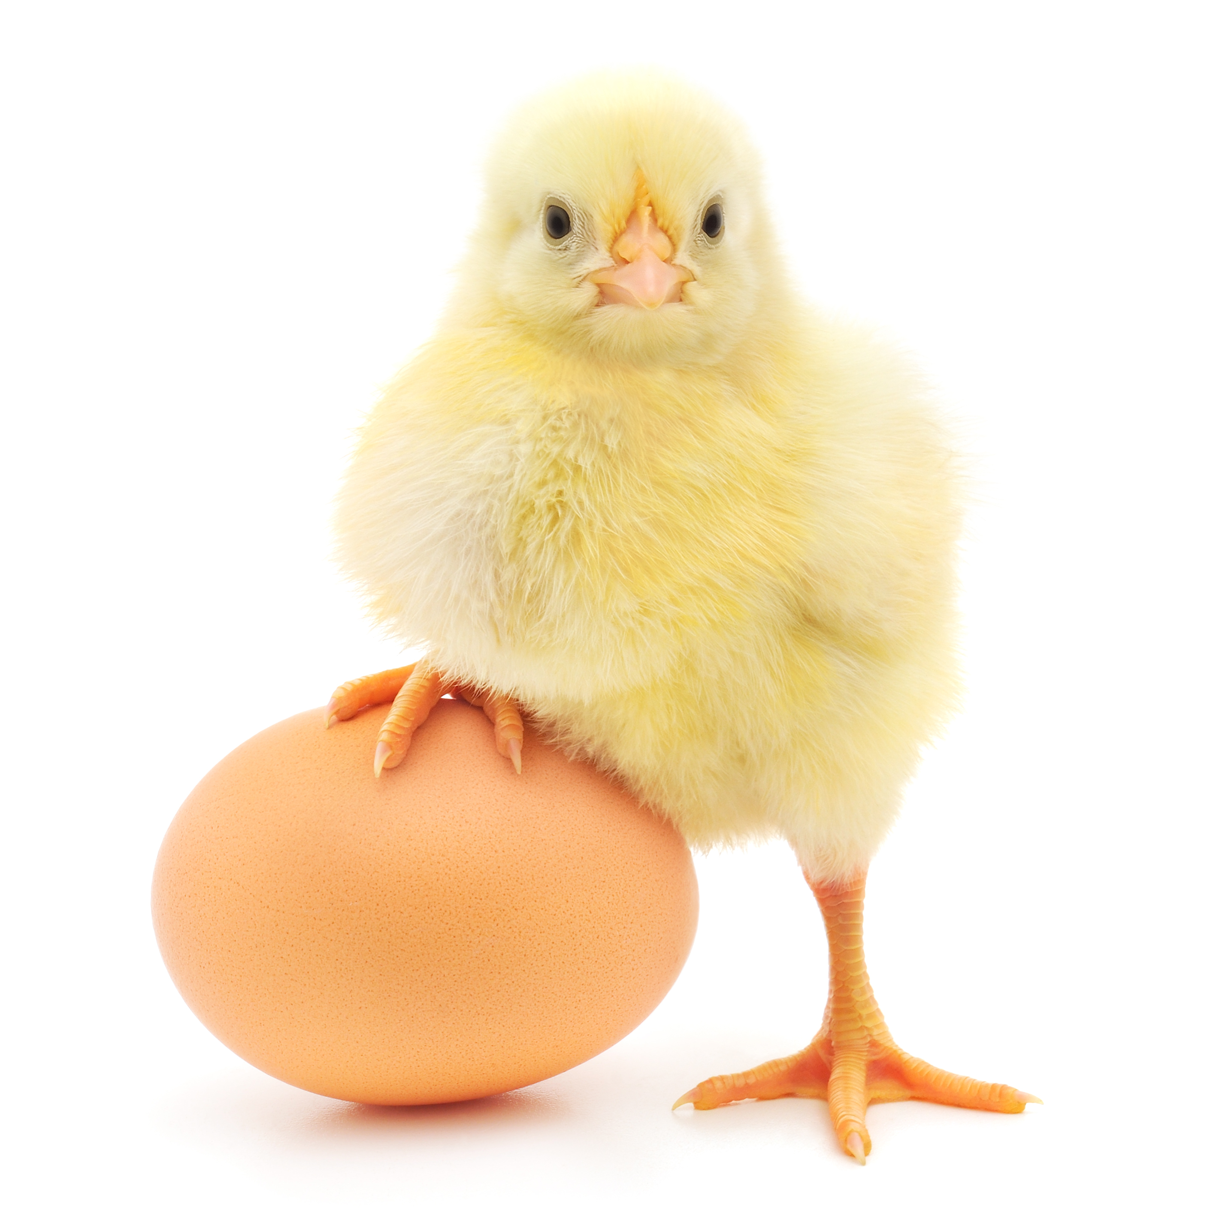
Attitude-Behavior Relations
Do we evaluate an object (attitude) and then behave?
Do we behave toward an object and then infer our attitudes?
Chicken or the egg conundrum …

Slide 16
Figure of Attitude-Behavior Relations
ATTITUDES
BEHAVIOR
OR
BEHAVIOR
ATTITUDES

Slide 17
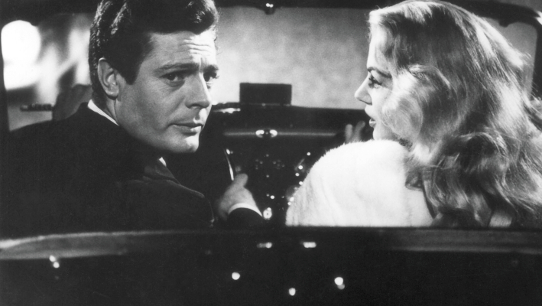
Federico Fellini is a terrific movie director, let’s watch his movies!
I have seen all of Fellini’s movies, so I guess I like his work!
*Remember, with cross-sectional surveys it is hard to infer causation
Examples
of the
“Conundrum”

Slide 18
ATTITUDES
PAST
BEHAVIOR
NORMATIVE
PRESSURE
INTENTIONS
COVARIATES
BEHAVIOR
PERCEIVED
BEHAVIORAL
CONTROL
Theory of Planned Behavior

Slide 19
Perhaps Even More Importantly …
“You have been looking at your data incorrectly”

Slide 20

Variable-Centered Analyses
What do we emphasize when we examine variable-to-variable relationships?
Overlap in distributions (how related are two constructs),
Prediction (variance accounted for in response),
Efficiency (pitting one predictor against another)
Person-Centered vs. Variable-Centered Analyses
or, “The search for typologies”

Slide 21
Typical Linear Regression Model
Predictor
β₁
Outcome
Demographics
Covariates
Confounds

Slide 22

Assumptions of Variable-Centered Analyses?
The obtained coefficient holds for all members of the population
For a unit change in X there is a corresponding change in Y
Stated differently, whatever the “effect” of X on Y (predictor on outcome) it holds for all members of the population
Individual differences (straying from the mean) is treated as error

Slide 23

Person-Centered Analyses
Purpose?
Elucidate typologies (mixtures or latent taxa)
LCA = Latent Class Analysis
LTA = Latent Transition Analysis
GMM = Growth Mixture Models
All use response patterns as the focus

Slide 24


Pictorial Representation of LCA

Slide 25

What is a response pattern?
We have two manifest questions, each coded Yes/ No; therefore, we have 2² or 4 response patterns:
YY, YN, NY, and NN
If we have 8 questions, each coded Y/N we have 2⁸ = 256 possible response patterns, making it a bit more difficult to “see” the different subgroups that might underlie the data

Slide 26

What is a typology?
With cross-sectional studies, typologies are “classes” or subgroups that share behavioral similarity (i.e., coping strategies)
With longitudinal studies (LTA), typologies are “statuses” as membership can fluctuate over time (people move from one status to another).
People within a class (or status) share common response profiles, they act in a similar fashion, share characteristics that are defining based on how they respond to survey questions

Slide 27
Latent
Class
Analysis
Model
I₁
I₂
“C”
I₃
I₄
I_{k}

Slide 28
Latent Class Multiple Group Model: Knownclass
I₁
I₂
I₃
I₄
“cg”
“C”

Slide 29
Latent Class Model with a Covariate
I₁
I₂
I₃
I₄
“C”
x

Slide 30
Mixture Model with Covariates and
Distal Outcome
I₁
I₂
I₃
I₄
I₅
“C”
y
x₁
x₂

Slide 31

COVID-19 STUDY OF COPING
Questions
Problem-focused coping:
e.g., “Think about choices that exist before I take any action”
Emotion-focused coping
e.g., “I get upset and let my emotions out”
Resilience
e.g., “It does not take me long to recover from a stressful event”
Cognitive Flexibility
e.g., “If I have failed to cope with stress, I think of other ways to cope”

Slide 32

IRPs
=
Typologies
3-Class Latent Class Analysis Example
Class #1 |  |  |  | Class #2 |  |  |  | Class #3
 | Threshold | IRP |  |  | Threshold | IRP |  |  | Threshold | IRP
Prob1 | -3.142 | 0.959 |  | Prob1 | -1.32 | 0.789 |  | Prob1 | -1.665 | 0.841
Prob2 | -1.975 | 0.878 |  | Prob2 | -1.181 | 0.765 |  | Prob2 | -1.384 | 0.800
Prob3 | -2.183 | 0.899 |  | Prob3 | -0.958 | 0.723 |  | Prob3 | -1.738 | 0.850
Prob4 | -2.796 | 0.942 |  | Prob4 | -1.663 | 0.841 |  | Prob4 | -1.663 | 0.841
Prob5 | -1.478 | 0.814 |  | Prob5 | -1.164 | 0.762 |  | Prob5 | -1.035 | 0.738
Prob6 | -1.444 | 0.809 |  | Prob6 | -0.852 | 0.701 |  | Prob6 | -1.069 | 0.744
Prob7 | -0.427 | 0.605 |  | Prob7 | 0.023 | 0.494 |  | Prob7 | 0.122 | 0.470
Emot1 | 2.009 | 0.118 |  | Emot1 | -3.722 | 0.976 |  | Emot1 | 2.548 | 0.073
Emot2 | 1.163 | 0.238 |  | Emot2 | -1.32 | 0.789 |  | Emot2 | 1.213 | 0.229
Emot3 | 2.065 | 0.113 |  | Emot3 | -1.403 | 0.803 |  | Emot3 | 2.095 | 0.110
Emot4 | 0.823 | 0.305 |  | Emot4 | -0.976 | 0.726 |  | Emot4 | 0.925 | 0.284
RESIL1 | -1.791 | 0.857 |  | RESIL1 | 0.908 | 0.287 |  | RESIL1 | -1.007 | 0.732
RESIL2 | -1.795 | 0.858 |  | RESIL2 | 2.08 | 0.111 |  | RESIL2 | -1.034 | 0.738
RESIL3 | -1.629 | 0.836 |  | RESIL3 | 1.553 | 0.175 |  | RESIL3 | -0.543 | 0.633
RESIL4 | -2.257 | 0.905 |  | RESIL4 | 1.267 | 0.220 |  | RESIL4 | -1.278 | 0.782
RESIL5 | -0.944 | 0.720 |  | RESIL5 | 0.881 | 0.293 |  | RESIL5 | -0.773 | 0.684
RESIL6 | -1.241 | 0.776 |  | RESIL6 | 1.311 | 0.212 |  | RESIL6 | -0.679 | 0.664
CogFlex1 | -2.359 | 0.914 |  | CogFlex1 | -1.137 | 0.757 |  | CogFlex1 | -0.064 | 0.516
CogFlex2 | -1.679 | 0.843 |  | CogFlex2 | -1.146 | 0.759 |  | CogFlex2 | -0.121 | 0.530
CogFlex3 | -2.824 | 0.944 |  | CogFlex3 | -2.007 | 0.882 |  | CogFlex3 | 2.561 | 0.072
CogFlex4 | -3.428 | 0.969 |  | CogFlex4 | -1.886 | 0.868 |  | CogFlex4 | 1.518 | 0.180
CogFlex5 | -2.279 | 0.907 |  | CogFlex5 | -1.67 | 0.842 |  | CogFlex5 | 1.107 | 0.248
Resilient, Flexible, Problem-Focused Copers (32.35%) |  |  |  | Non-Resilient, Flexible High-Use Copers (13.34%) |  |  |  | Resilient, Inflexible, Problem-Focused Copers (10.36%)

Slide 33
Mixture Model with diabetes patients (n = 176)

Slide 34
Mixture Model with vaccine reluctance study(n = 1011)

Slide 35
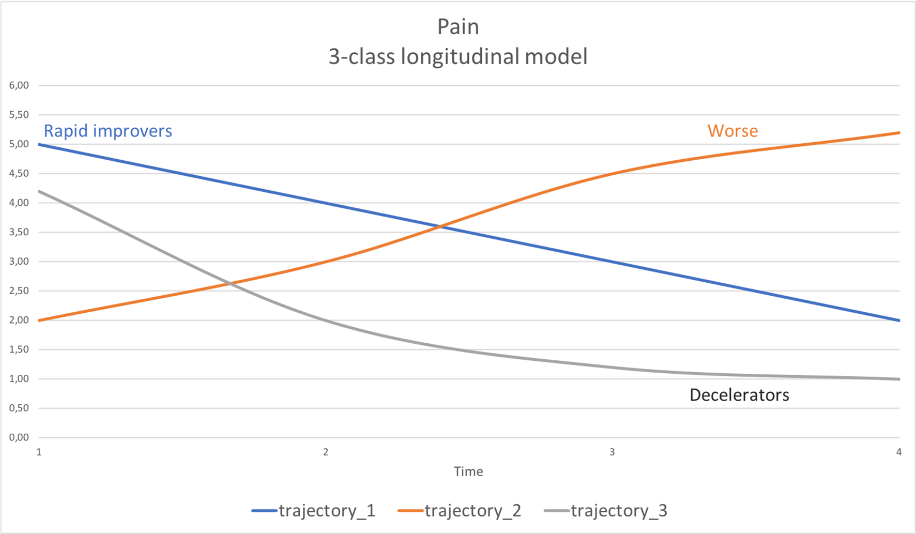
Drawing conclusions
Build your teams first Be inclusive = multiple disciplines Guide your research with substantive theory or rely on best hunches The quality of your data is only as good as the questions you ask Think through implementation of studies like a surgical procedure

Slide 36
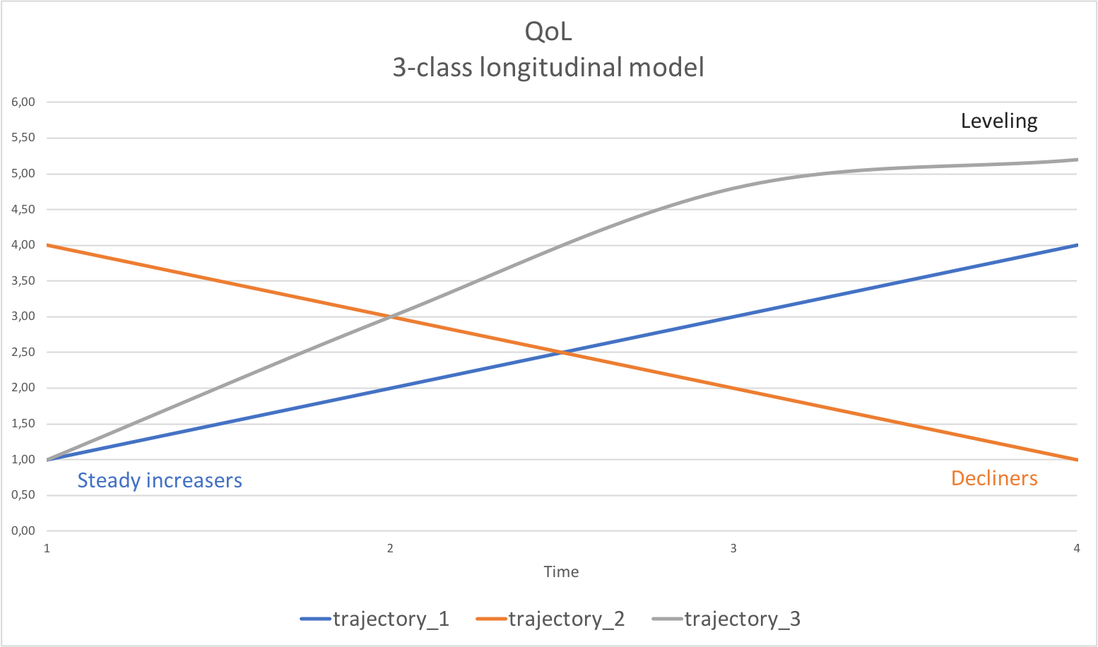

Slide 37
Drawing conclusions
Build your teams first Be inclusive = multiple disciplines Guide your research with substantive theory or rely on best hunches The quality of your data is only as good as the questions you ask Think through implementation of studies like a surgical procedure

